Slide 1
REPORT PRESENTATION
INTRODUCTION
The deployment of the computer has been unhurried to creep into the food service industry. Nonetheless, the usage of computers in the food industry is taking up a duration of dynamic growth. Some of the factors contributing to this rapid growth include rapid development and sophisticated technologies; competitive push requiring more coherent procedures, the increased availability and decreased cost of computers, and the increasing expense of food production. No once can overlook the importance of computers in every organization.

Slide 2
Computer System resources
Compute resources are divided into 2:
Hardware resources
Software resources

Slide 3
Main memory
This is the basic storage in computer system .
Main memory is usually known as RAM this enables first processing speed together with the CPU.
RAM requires a handsome amount of money.
ROM is auxiliary storage and is non volatile and less expensive compared to main memory but it necessity cannot be underrated.
The more auxiliary storage devices which accompany the RAM.

Slide 4
NETWORKS
Twisted cables
Work stations
Servers
Network bosters
NIC
Networks are necessary for connecting the different companies over the globe hence enhancing high networked production over the globe.

Slide 5
Network components
Each computer on the network must have a Network Interface Card (NIC). A NIC is the computer’s gateway to the network. The NIC attaches to the network via connection medium, usually a wire or cable, which attaches to the other computer. When there are more than two computers, their cables can connect to a hub. A hub is like the center of a tire with spokes emanating from it, each connecting to a separate computer or peripheral device. Hubs come in various sizes, defined by the number of ports or connections they offer. A switch is like an intelligent hub. A hub will broadcast a computer’s request to every device on the network, while a switch will direct the request directly to the recipient’s port. This helps relieve excess congestion and improve performance on the network. Most networks also have one or more central computers called servers. A server is a powerful version of a desktop computer.They are designed to be the managers of the network, performing such functions as file, print and email servers. Many organizations use routers in their offices today. Routers are devices that can connect separate networks together. They can be used to connect remote offices together, or to share an internet connection within the office. To protect a network, a firewall is often used. Firewalls are devices that sit between your Internet connection and your network. Their function is to protect your network’s security and ensure that no one breaks into your network. Networks require Network Operating Systems. Examples of such Operating Systems include Windows NT, Windows 2000 Server and Novell Netware. Low and no-cost options are readily available as well in the form of the various versions of Linux.

Slide 6
Network types
LAN this connects to one departments
MAN this connects over city
WAN this connects worldwide.

Slide 7
Peripheral devices
This includes the additional devices on a computer which may includes:
Scanners
Printers
Mouse
Keyboards
etc

Slide 8
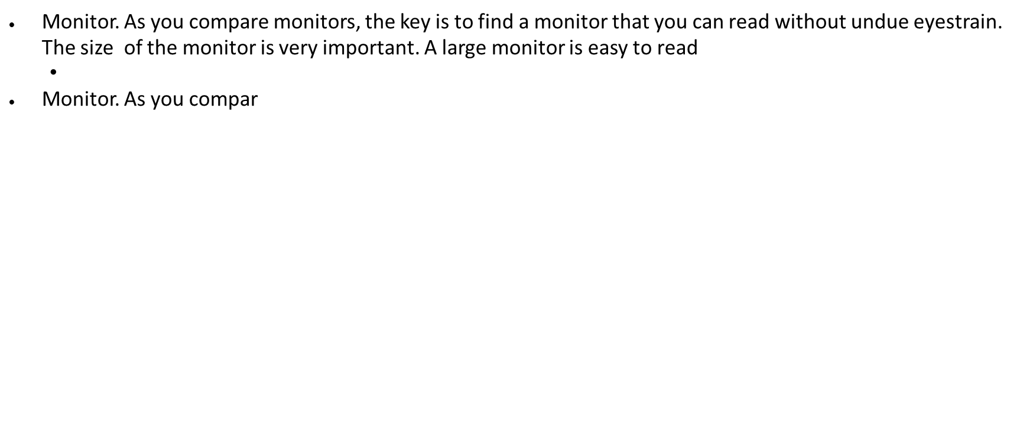
Monitor
The monitor is a display device of a computer
This the viewing point basically known as the computer
This will be used to display an computed output of the company

Slide 9
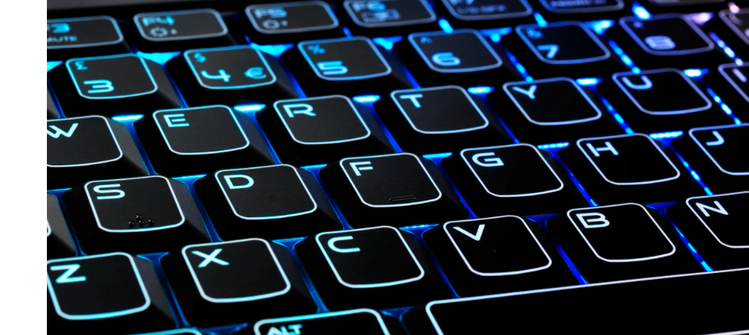
Keyboard
This is the keying device
There are several keyboards in the market some customized according specific languages
There are wireless keyboards and wired keyboards
It’s a input device

Slide 10

Mouse
A mouse is a pointing devices this facilitates selection of options and menu and it’s also an input device.
There are wired and wireless devices.

Slide 11
SECURITY
Security Technologies
Internet and EC security is a thriving business and several companies have come up with technologies to enhance internet security. Examples of security technologies include:
Firewall
A firewall is a network component consisting of both hardware and software that isolates a private network from a public network.
Intrusion detection system (IDS)
This is a special category of software that can monitor activity across a network or on a host computer, watch for suspicious activity, and take automated action based on what it sees
Digital certificates this is used in encrypting organizational data

Slide 12
severs
In computing, a server is computer hardware or software that provides functionality for other programs or devices, called client and the architecture is known as client–server model. Servers can provide various functionalities, often called "services", such as sharing data among multiple clients, or performing computation task for a client.
A virtual server is also needed for back up.

Slide 13
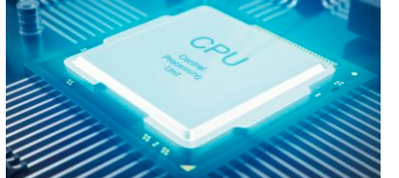
CPU
This the central Processing unit which helps in processing the output. The CPU is necessary in computing since it controls all the activities of processing output. Intel core 9 is the fastest. This will be a competitive advantage

Slide 14
